Slide 1

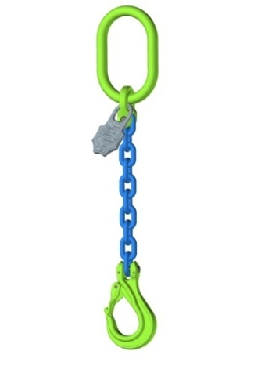
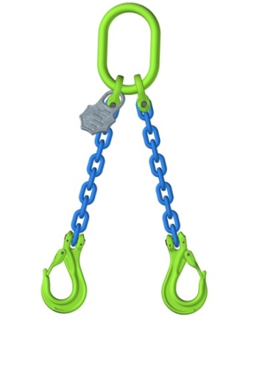
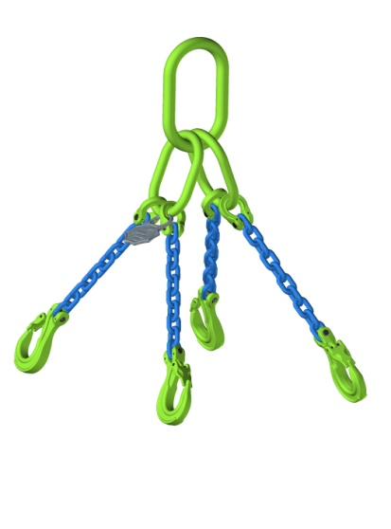
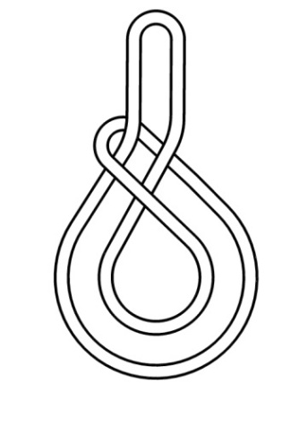
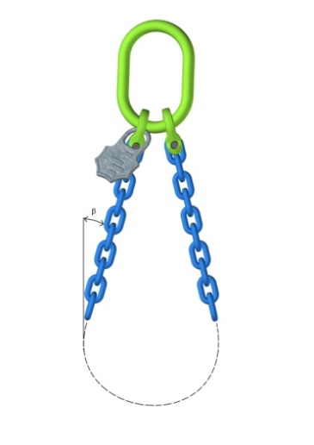
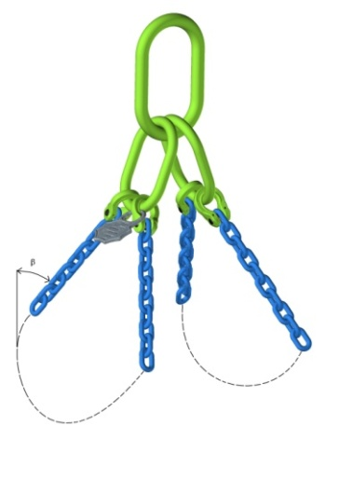
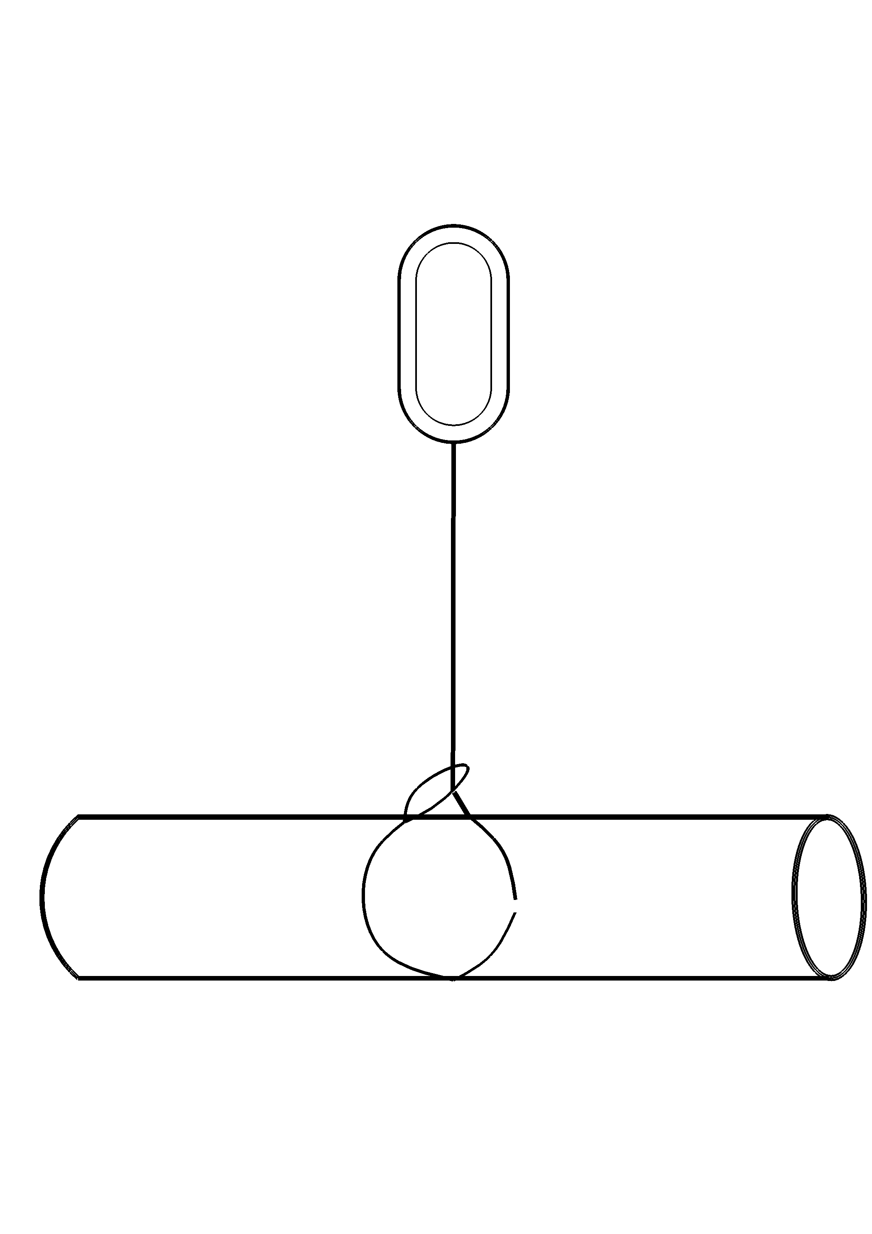
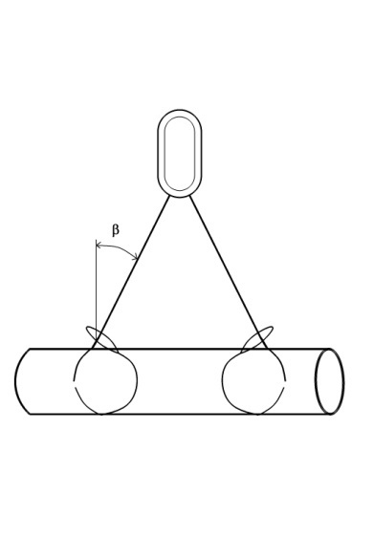
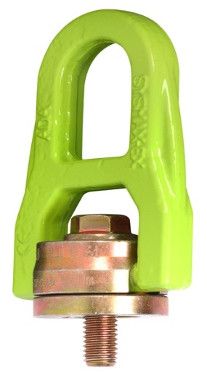
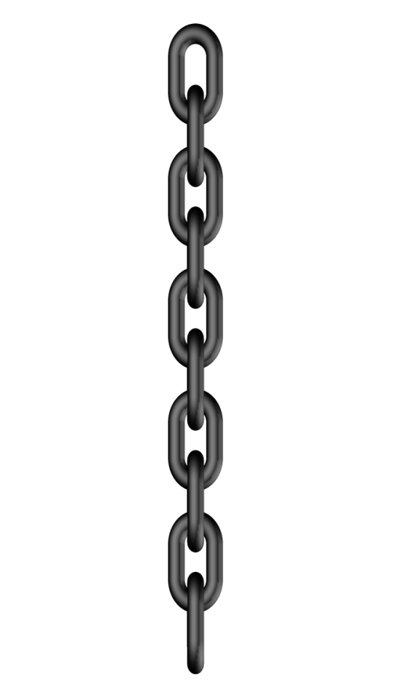
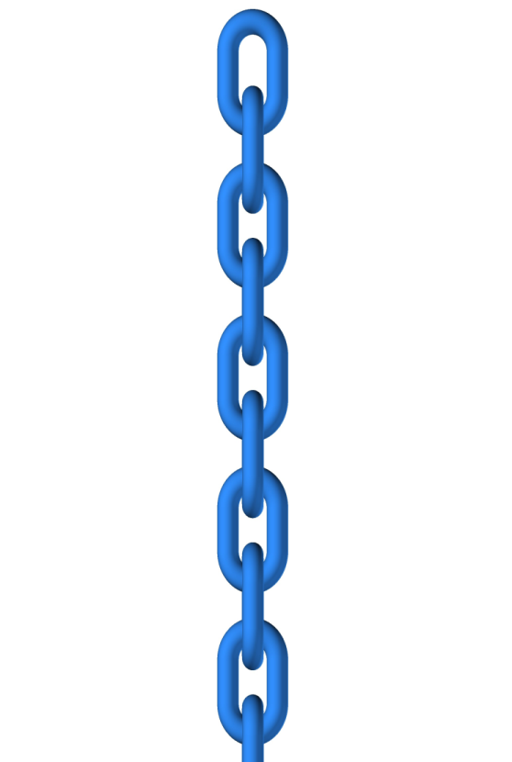
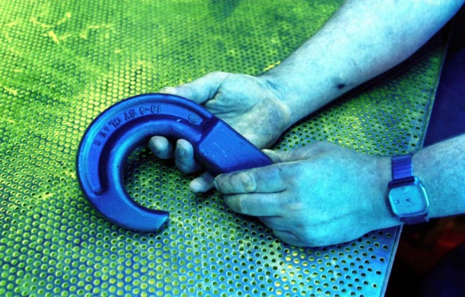
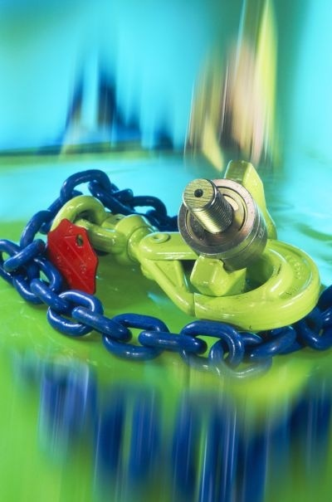
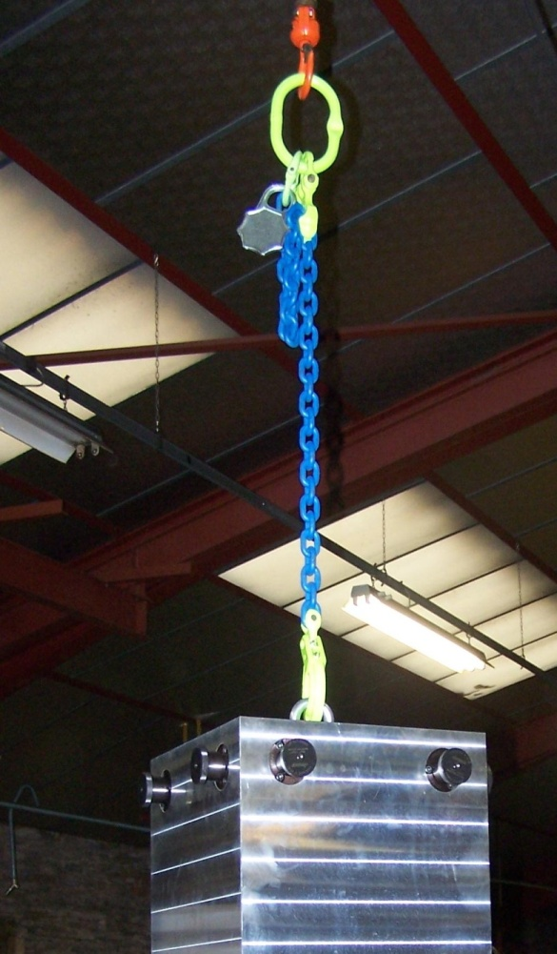
GRADE 80 AND GRADE 100
Working Load Limits (WLL) in tons
CHAIN SLINGS
 |  | 1 LEG | 2 LEGS |  | 3 and 4 LEGS |  | ENDLESS | BASKET SLING |  |  |  | CHOKE SLING
 |  |  |  |  |  |  |  | SINGLE (2 legs) |  | DOUBLE (4 legs) |  | SINGLE | DOUBLE
ANGLE β |  | 0 | 0-45° | 45-60° | 0-45° | 45-60° | - | 0-45° | 45-60° | 0-45° | 45-60° | 0° | 0-45° | 45-60°
COEFFICIENT |  | 1 | 1,4 | 1 | 2,1 | 1,5 | 1,6 | 1,1 | 0,8 | 1,7 | 1,2 | 0,8 | 1,1 | 0,8
Ø CHAIN | GRADE
Ø6 | GRADE 80 | 1,12 | 1,57 | 1,12 | 2,35 | 1,68 | 1,79 | 1,23 | 0,9 | 1,9 | 1,34 | 0,9 | 1,23 | 0,9
 | GRADE 100 | 1,4 | 1,96 | 1,4 | 2,94 | 2,1 | 2,24 | 1,54 | 1,12 | 2,38 | 1,68 | 1,12 | 1,54 | 1,12
Ø7 | GRADE 80 | 1,5 | 2,1 | 1,5 | 3,15 | 2,25 | 2,4 | 1,65 | 1,2 | 2,55 | 1,8 | 1,2 | 1,65 | 1,2
 | GRADE 100 | 1,88 | 2,63 | 1,88 | 3,94 | 2,81 | 3,0 | 2,06 | 1,5 | 3,19 | 2,25 | 1,5 | 2,06 | 1,5
Ø8 | GRADE 80 | 2,0 | 2,8 | 2,0 | 4,2 | 3,0 | 3,2 | 2,2 | 1,6 | 3,4 | 2,4 | 1,6 | 2,2 | 1,6
 | GRADE 100 | 2,5 | 3,5 | 2,5 | 5,25 | 3,75 | 4,0 | 2,75 | 2,0 | 4,25 | 3,0 | 2,0 | 2,75 | 2,0
Ø10 | GRADE 80 | 3,15 | 4,41 | 3,15 | 6,62 | 4,73 | 5,04 | 3,47 | 2,52 | 5,36 | 3,78 | 2,52 | 3,47 | 2,52
 | GRADE 100 | 3,94 | 5,51 | 3,94 | 8,27 | 5,91 | 6,3 | 4,33 | 3,15 | 6,69 | 4,73 | 3,15 | 4,33 | 3,15
Ø13 | GRADE 80 | 5,3 | 7,42 | 5,3 | 11,13 | 7,95 | 8,48 | 5,83 | 4,24 | 9,01 | 6,36 | 4,24 | 5,83 | 4,24
 | GRADE 100 | 6,63 | 9,28 | 6,63 | 13,91 | 9,94 | 10,6 | 7,29 | 5,3 | 11,26 | 7,95 | 5,3 | 7,29 | 5,3
Ø16 | GRADE 80 | 8,0 | 11,2 | 8,0 | 16,8 | 12,0 | 12,8 | 8,8 | 6,4 | 13,6 | 9,6 | 6,4 | 8,8 | 6,4
 | GRADE 100 | 10,0 | 14,0 | 10,0 | 21,0 | 15,0 | 16,0 | 11,0 | 8,0 | 17,0 | 12,0 | 8,0 | 11,0 | 8,0
Ø18 | GRADE 80 | 10,0 | 14,0 | 10,0 | 21,0 | 15,0 | 16,0 | 11,0 | 8,0 | 17,0 | 12,0 | 8,0 | 11,0 | 8,0
Ø19 | GRADE 80 | 11.2 | 15.68 | 11.2 | 23.52 | 16.8 | 17.92 | 12.32 | 8.96 | 19.04 | 13.44 | 8.96 | 12.32 | 8.96
 | GRADE 100 | 14.0 | 19.6 | 14.0 | 19.4 | 21.0 | 22.4 | 15.4 | 11.2 | 23.8 | 16.8 | 11.2 | 15.4 | 11.2
Ø20 | GRADE 80 | 12,5 | 17,5 | 12,5 | 26,25 | 18,75 | 20,0 | 13,75 | 10,0 | 21,25 | 15,0 | 10,0 | 13,75 | 10,0
 | GRADE 100 | 15,63 | 21,88 | 15,63 | 32,81 | 23,44 | 25,0 | 17,19 | 12,5 | 26,56 | 18,75 | 12,5 | 17,19 | 12,5
Ø22 | GRADE 80 | 15,0 | 21,0 | 15,0 | 31,5 | 22,5 | 24,0 | 16,5 | 12,0 | 25,5 | 18,0 | 12,0 | 16,5 | 12,0
 | GRADE 100 | 18,75 | 26,25 | 18,75 | 39,38 | 28,13 | 30,0 | 20,63 | 15,0 | 31,88 | 22,5 | 15,0 | 20,63 | 15,0
Ø26 | GRADE 80 | 21,2 | 29,68 | 21,2 | 44,52 | 31,8 | 33,92 | 23,32 | 16,96 | 36,04 | 25,44 | 16,96 | 23,32 | 16,96
 | GRADE 100 | 26,5 | 37,1 | 26,5 | 55,65 | 39,75 | 42,4 | 29,15 | 21,2 | 45,05 | 31,8 | 21,2 | 29,15 | 21,2
Ø32 | GRADE 80 | 31,5 | 44,1 | 31,5 | 66,15 | 47,25 | 50,4 | 34,65 | 25,2 | 53,55 | 37,8 | 25,2 | 34,65 | 25,2
GRADE 80
GRADE 100
TEMPERATURE OF USE
GRADE 80 Accessories and chain
Temperature | -40° to + 200 °C | 200 ° to 300°C | 300° to 400°C | > 400° C
WLL reduction | 0 | -10% | -25% | Forbidden
GRADE 100 Accessories
Temperature | -40° to + 200 °C | 200 ° to 300°C | 300° to 380°C | > 380° C
WLL reduction | 0 | -10% | -25% | Forbidden
GRADE 100 chain
Temperature | -40° to + 200 °C | > 200 °
WLL reduction | 0 | Forbidden
www.forge-france.com

